Slide 2
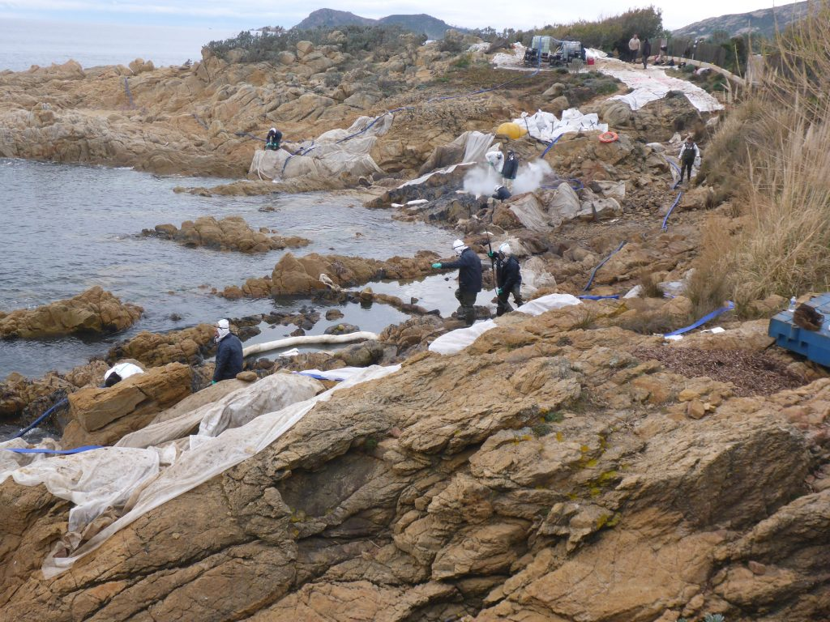
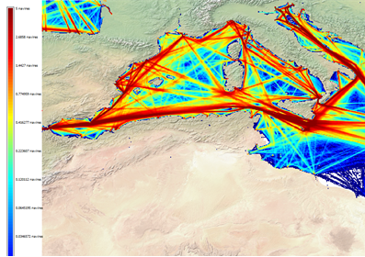
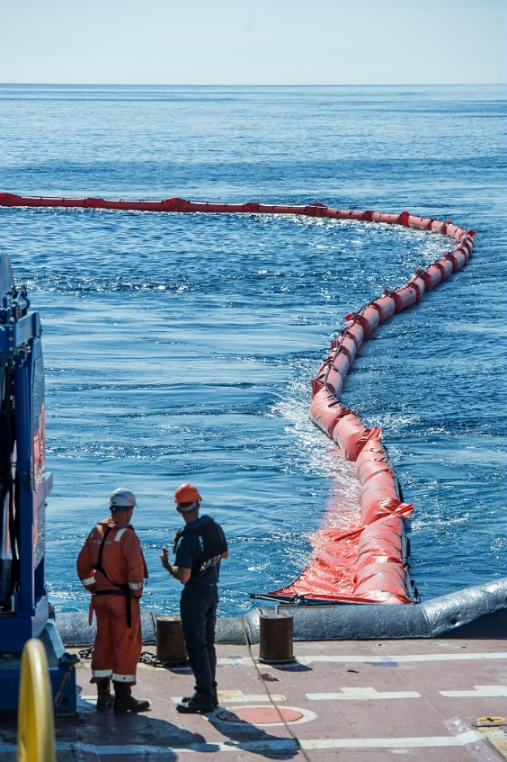
Trafic density map (AIS data)
©MESRI & INERIS 2018
Pollution response at sea and on land
Ulysse/Virginia collision
October 2018
Credits: Cedre
To consult the whole report on the State of the Environment and Development in the Mediterran : https://planbleu.org/soed/
Credits: Marine Nationale

Slide 3
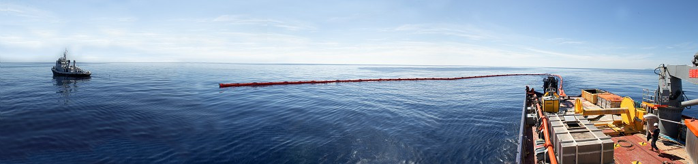
Strengthen collaboration and cooperation in the Western Mediterranean in the field of preparedness for and response to oil and HNS pollution
© Marine Nationale

Slide 4
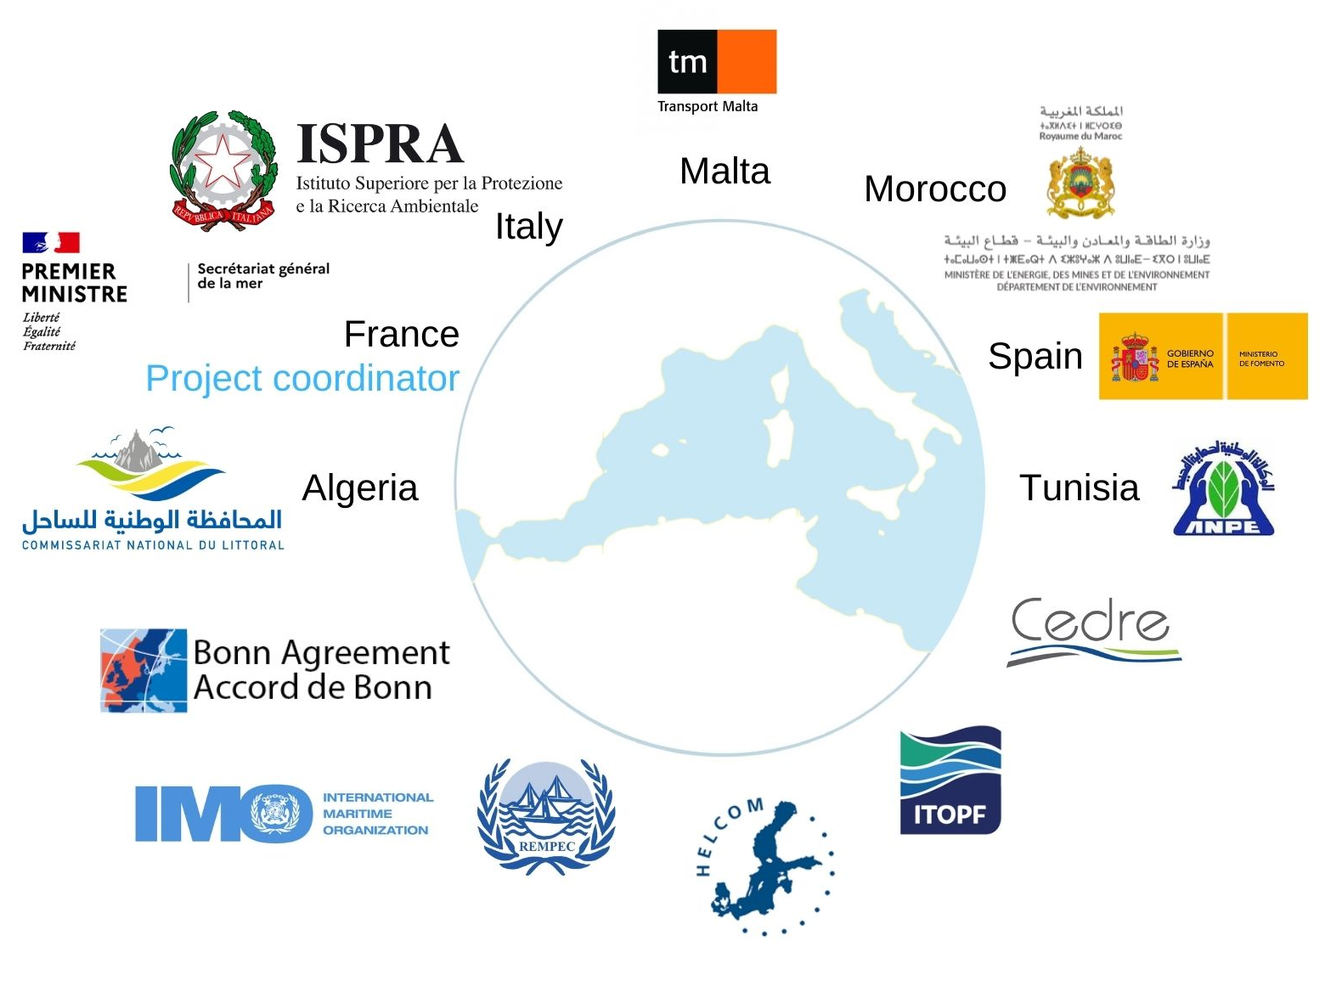
Project Consortium
Budget: EUR 868,416.39
Funding : DG ECHO – Union Civil Protection Mechanism (UCPM 2018)
Started in January 2019

Slide 5
Specific objectives
Enhancing emergency decision-making capabilities
Assessing national oil spill response programmes
Strengthening cooperation between sub-regional plans and arrangements and national emergency procedures
Notes:
In support of Specific Objectives 17, 19, 20, 21 & 22 of REMPEC Regional Strategy

Slide 6
Update of
decision support tools
Inter-regional HNS Response Manual between REMPEC, HELCOM and Bonn Agreement
Update and upgrade to
MIDSIS-TROCS 4.0
Notes:
Update of decision support tools
Inter-regional HNS Response Manual between REMPEC, HELCOM and Bonn Agreement, developed by Cedre, ITOPF & ISPRA. Major steps in the drafting process are presented to Member States of each region during dedicated working groups or focal points meeting. First in June 2019 during REMPEC correspondents meeting in Malta, February 2020 during HELCOM Response Working Group meeting, May 2020 OTSOPA, and finally during MEDEXPOL 2020 in October 2020
Update and upgrade of the Maritime integrated Decision support information system MIDSIS TROCS hosted by REMPEC,integrating the findings of the HNS Manual

Slide 7
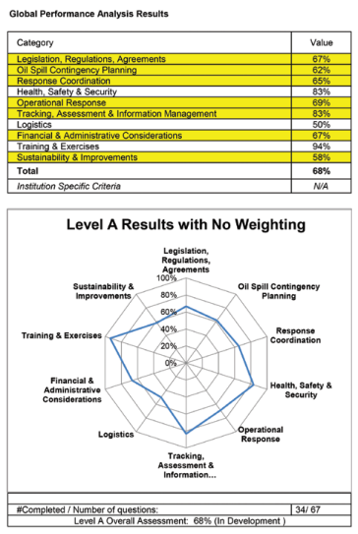
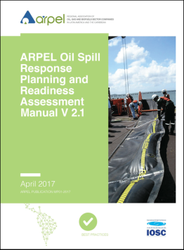
Assessment of national oil spill response programmes
Training on the use of the Manual and Readiness Evaluation Tool for Oil Spills
Gap and performance analysis using the tool and development of improvement programmes
Notes:
Assessment of national oil spill contingency planning
Developed in the Caribbean with the aim of being an internationally used tool.
Can be adapted to every situation, after a specific training on the tool organized by REMPEC (24-26 April 2019, Valletta, Malta), each Beneficiary, with technical assistance funded by the project, conducts its national evaluation with the tool. (Already Malta, France and Italy in October 2019, Spain in December 2019 and Morocco in January 2020, Tunisia in and Algeria in March 2020). Provided global gap analyses and developed global improvement programmes.

Slide 8
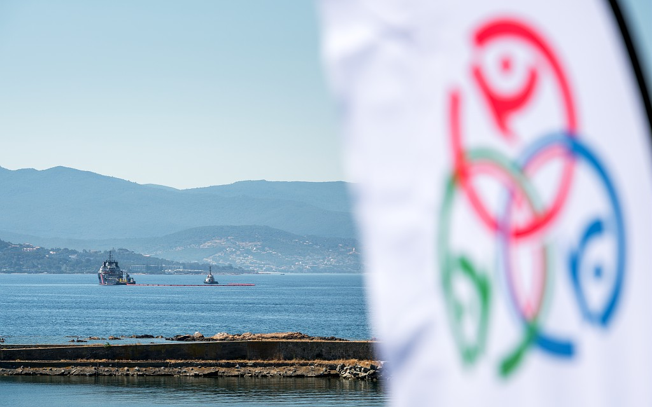


Strengthening synergies between emergency procedures
Manuals on national mechanisms for the mobilisation of response equipment and experts in case of emergency
Feasibility study on synergies between existing Sub-regional agreements and plans (RAMOGEPOL, LION PLAN & AMT)
Training on CECIS Marine Pollution (DG ECHO) and Roadmap for the set up of a Common Emergency Communication System in the Mediterranean
Notes:
Development of manuals on the national mechanisms for the mobilisation of response equipment and experts in case of emergency (in progress), to facilitate sub-regional cooperation in pollution response – give a picture of availability of equipment in the sub-region and to update REMPEC data bases MEDGIS MAR and Country Profile (reporting requirements of the Mediterranean Emergency protocol 2002 and OPRC 1990 Convention).
Study on synergies between existing Sub-regional agreements and plans (RAMOGEPOL, LION PLAN & AMT) (joint activities, exercices etc.), to supplement future regional and sub regional work programmes, prepared by SGMer. Provides operational recommendations and pre-requisites to strengthen cooperation in the long term. Results available on the project website.
Workshop to discuss the set-up of a regional common emergency communication system and training on the use of the CECIS MP (DG ECHO), organised by REMPEC and DG ECHO in Bruxelles 22-23 October 2019. Participants from West MOPoCo as well as representatives of other Parties to the Barcelona Convention with support of DG ECHO. Participants concluded in principle on the use of CECIS MP as a regional emergency communications system. REMPEC then conducted a survey addressed to Contracting Parties to the Barcelona Convention on needs and requirements for the set up of a common emergency communication system. Recommendations and propositions based on the outcomes of the survey are presented during MEDEXPOL 2020.

Slide 9
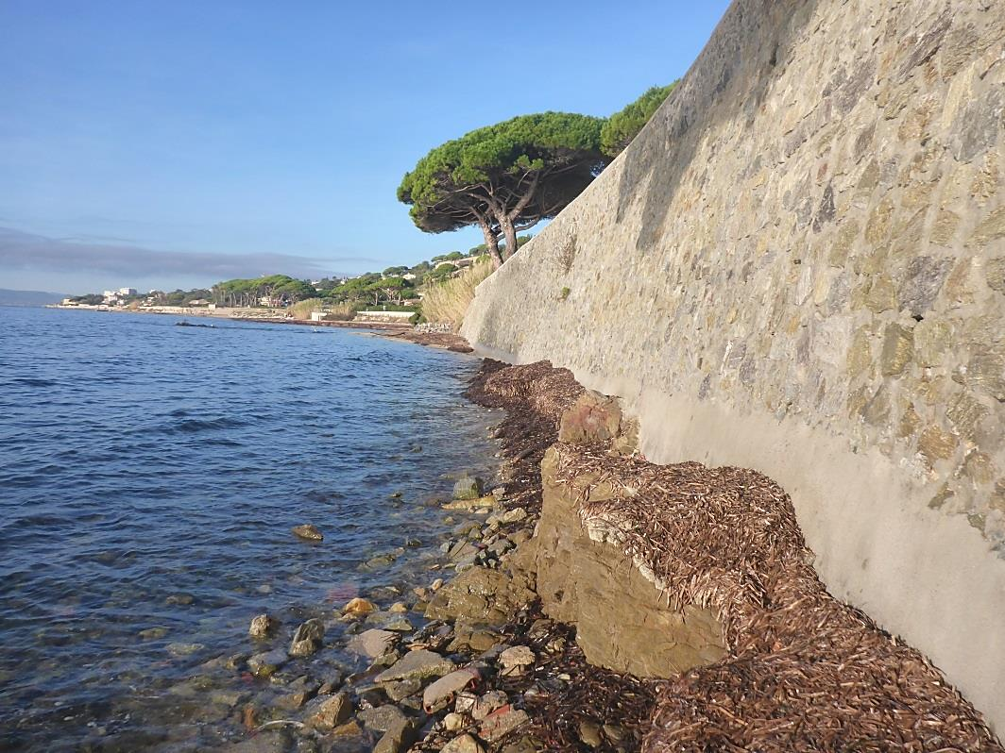


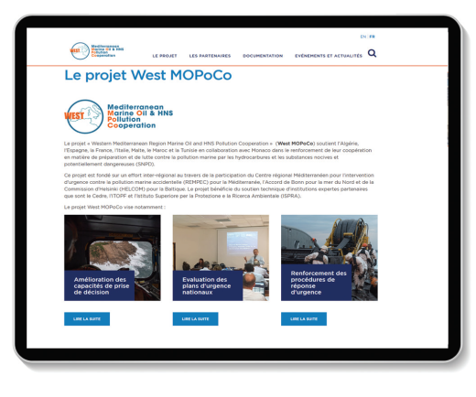
Contact: Mathilde Kraft
mathilde.kraft@pm.gouv.fr
More information on the project at:

